Slide 1
Team Tuesday 8
ResortOS (Resort Project)
Cristian Mendoza, Todd Bauer, Brandon Baker, Jose Silvestre, Gerardo Ortiz, Chase Canales

Slide 2
Video Presentation
https://drive.google.com/open?id=1i4Q9xL-kNfXpYeR9rgmFXN95YTs5evEu

Slide 3
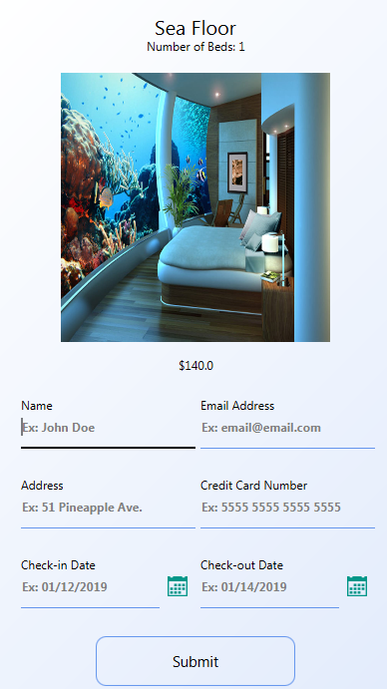
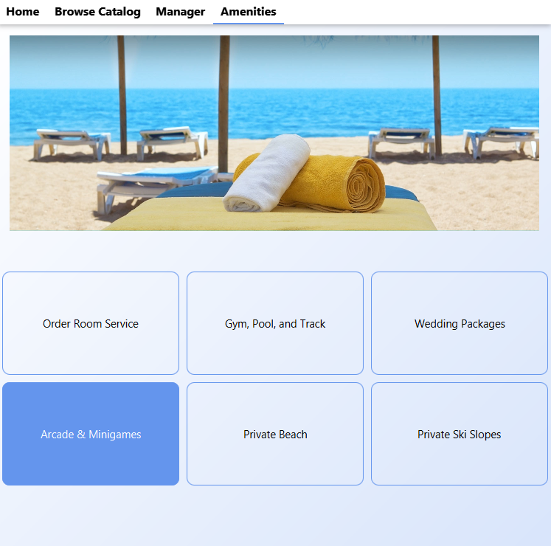
Summary
What technologies did you use?
SQL Database (H2)
IntelliJ IDE
Brief Description
Ability to book/cancel rooms, view general resort information, generate reports and view statistics, and handle pertinent booking information when logged in as a manager.
What does not work?
Once a room is booked, the vacant label does not switch to occupied in the manager room view and DB.

Slide 4
Questions?

